Slide 1


Department of BES-1
Data Structures
Course code:24SC1203
Topic:
BuCKET SORT

Slide 2



AIM OF THE SESSION
To familiarize students with the basic concept of Bucket Sort Algorithm concepts and analyze Time Complexity.
INSTRUCTIONAL OBJECTIVES
This Session is designed to:
Demonstrate : Bucket Sort Approach
Describe : Bucket Sort algorithm
List out the :Applications of Bucket sort
Describe the : Time complexity of Bucket sort
LEARNING OUTCOMES
At the end of this session, you should be able to:
Define : Bucket sort algorithm
Describe : Time complexity of bucket sort
Summarize : Bucket sort algorithm

Slide 3
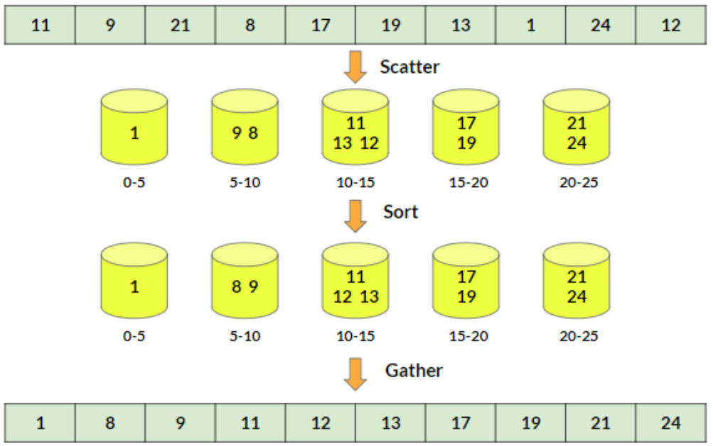
Bucket Sort INTRODUCTION
Bucket Sort is a sorting technique that sorts the elements by first dividing the elements into several groups called buckets.

Slide 4
Bucket Sort DESCRIPTION
Bucket sort works on uniformly distributed data and puts numbers into buckets to sort and gather them all to form the sorted array.
Uniformly Distributed Data
  Uniformly distributed data has difference between every adjacent element almost the same.
  An array is said to be uniformly distributed if the difference between each adjacent element inside the array is almost the same. Or, in other terms, the elements of the array spread evenly throughout the whole span/range of the array.

Slide 5
Bucket Sort Approach
Bucket sort is a sorting technique that uses the Scatter-Gather-Approach to sort the array. It divides the unsorted array into separate groups and calls them buckets. Sort the individual buckets, and then gather them all together to form the final sorted array.
Scatter-Gather-Approach
Solving large and complex problems can be a little hard at times.
Scatter-gather-approach tries to simplify such complex problems by first scattering the complete data into clusters, solving these sub-problems individually, and finally gathering them all together to get the final result.

Slide 6
Algorithm
bucketSorting(arr, n):​
Create n empty buckets​
loop through each element of the arr and do the following​ Calculate bucketIndex​
  Insert the element into the corresponding bucket number​
Sort the individual buckets​
Gather all the elements together​

Slide 7

Example
Step 1:
Since we have the array with integer elements, we'll calculate the range first.
maximumElement = 24
minimumElement = 1
noOfBuckets = 5 (will be given as parameter)
range = (int)(24 - 1) / 5
= 4
Hence, we'll have buckets of the following ranges:
[1-5] [6-10] [11-15] [16-20] [21-25]

Slide 8

Example
Step 2: Scatter
Now, iterate through the unsorted array and keep inserting the numbers in the bucket of their corresponding range.
For example:
array[0] = 11, Range = [11-15]
array[1] = 9, Range = [6-10]
array[2] = 21, Range = [21-25]
array[3] = 8, Range = [6-10]
array[4] = 17, Range = [16-20]

Slide 9
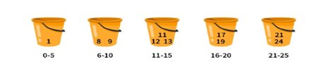
Example
Step 3:
Now sort all the elements in each of the buckets, and the sorted buckets look like this:

Slide 10

Example
Step 4: Gather
At last, visit each bucket and gather all the numbers together. Merge them all, and we'll get the sorted array.

Slide 11
Time Complexity
Bucket Sort time complexity
  Best Case Time Complexity: O(n+k)
  Average Case Time Complexity: O(n)
  Worst Case Time Complexity: O(n^2^)

Slide 12
SUMMARY
Bucket sort works on uniformly distributed data and puts numbers into buckets to sort and gather them all to form the sorted array.
Bucket sort is also known as bin sort. It is a sorting algorithm that divides an array’s items into a number of buckets.
While conventional sorting algorithms can reach the best case time complexity of O(nlogn), Bucket sort can do the same in O(n).

Slide 13
SELF-ASSESSMENT QUESTIONS
What is the alternate name of bucket sort?
a) group sort
b) radix sort
c) bin sort
d) uniform sort
2. Bucket sort is most efficient in the case when __________
a) the input is non uniformly distributed
b) the input is uniformly distributed
c) the input is randomly distributed
d) the input range is large

Slide 14
TERMINAL QUESTIONS
1. Describe Bucket Sort approach?
2. List out Applications of Bucket sort
3. Analyze Time complexity of Bucket sort
4. Summarize Bucket Sort Algorithm

Slide 15
REFERENCES FOR FURTHER LEARNING OF THE SESSION
Reference Books:
Mark Allen Weiss, Data Structures and Algorithm Analysis in C, 2010 , Second Edition, PearsonEducation(CH 7.5 Page no 242- 245).
Sites and Web links:
https://www.youtube.com/watch?v=E9OccfF9mpI
https://www.scaler.com/topics/data-structures/bucket-sort/

Slide 16
THANK YOU
CO1 – Data Structures

